Slide 1
Exception handling and other new features of the Component Plugin
Presented by Victor Chen, JPL Summer Internship 2015

Slide 2
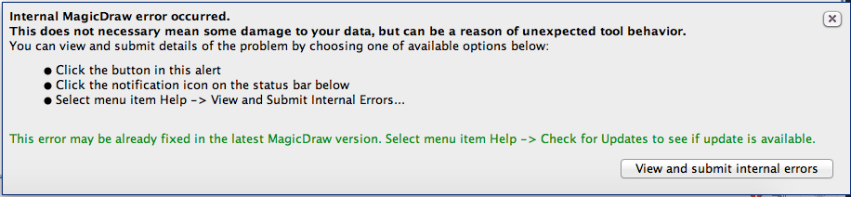
Purpose
Previously, when the Component Plugin encountered fatal errors, it crashed without telling the user why
Even if the xml generation completed, there were many sanity checks that were missing
Simple mistakes could lead to dramatic failures later along in the build

Slide 3
Fatal Exceptions
Errors in the model that the user needs to fix to prevent crashes later in the process
Ports that have no specified types
Connections between ports with types that do not match
Connections between two input ports
Connections between two output ports
Connections with no source/target components
Connections with the same multiplicity originating from the same output port
Passive components with asynchronous input
Arguments of ports have no data type

Slide 4
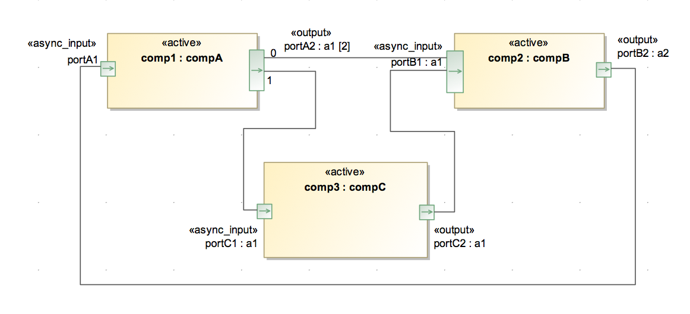
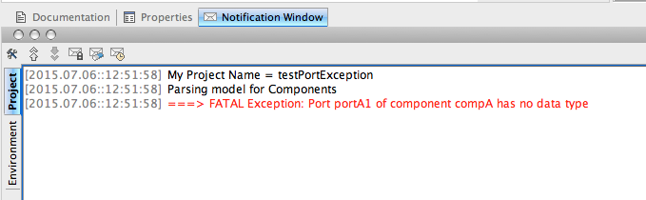
Fatal Exception Example

Slide 5
Warnings
Potential mistakes in the model that should be pointed out to the user, but execution is allowed to continue.
Active components with no asynchronous input ports
Queued components with no asynchronous input ports
Queued components with no synchronous input ports
Ports with no connections

Slide 6
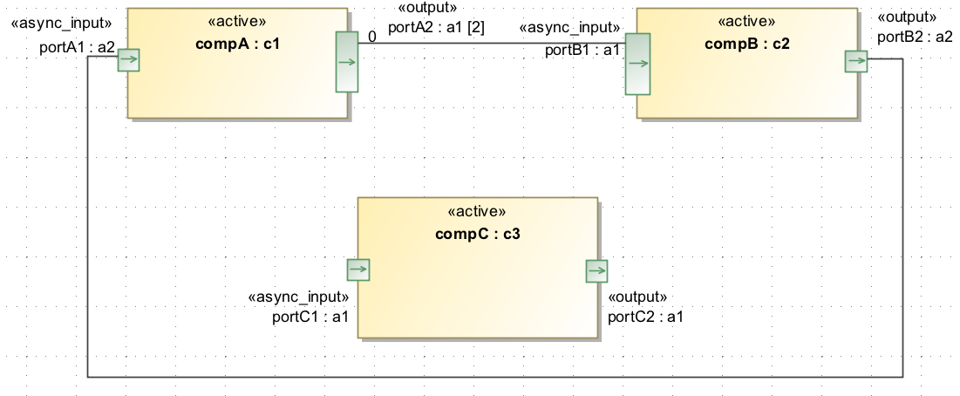
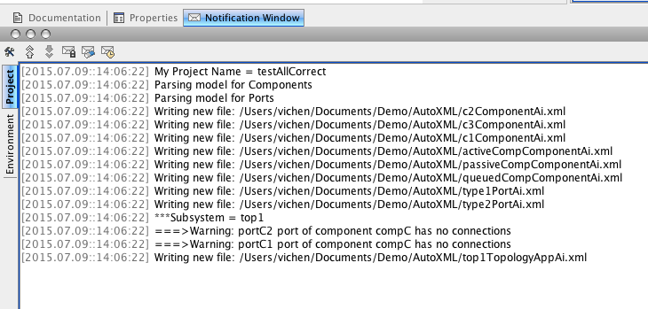
Warning Example

Slide 7
Implementation
Three exception classes used
ComponentException, ConnectorException, PortException
Have little functionality implemented
Port type checks are done in ProcessISFProject, in methods processComponents and processPorts
Component errors and warnings are handled in ISFComponent
void method checkComponent() checks fatal exceptions and warnings
helper method isValid(String stereotype, String portType, boolean atLeastOne)

Slide 8
Implementation
Topology warnings and exception handlers are implemented in ISFSubsystem
Method validatePhysicalConnections() is called at the end of createPhysicalConnections()
Gets a list of all ports in the topology
Compares this with a list of all ports that have connections

Slide 9
Implementation
The method testConnectionDirection(Connector conn) is called on each connector to check if it is from an output port to an input port
validatePhysicalConnections() also gives warnings for ports without connections
validatePhysicalConnections() checks that the types at the ends of connectors match

Slide 10
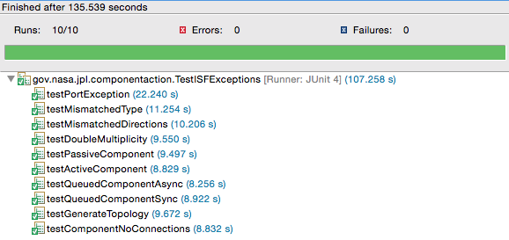
JUnit tests for exceptions
Created JUnit test cases for every exception handled, and a test suite to run all the tests (TestISFExceptions)
Created separate test models that throw various exceptions
Tests check if fatal exceptions occur and throw runtime exceptions
Tests check if warnings are written to the log
Currently, the tests take a while to run

Slide 11
Command Line Tool
MagicDraw cannot be run on headless devices, even in batch mode
Experimented with the MagicDraw API for running in batch mode and found that it lessened the time needed to generate code
Wrote class IsfCommandLine that extends the MagicDraw CommandLine class
Can pass in a package name to the command line utility if only one package needs to be processed
Can be useful for automating the process

Slide 12

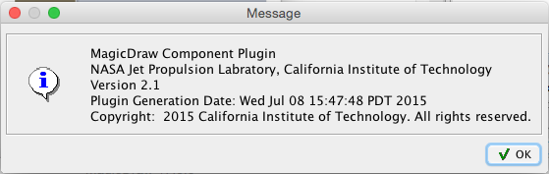
About button
Added “about” option to Component Autocoder plugin menu in MagicDraw

Slide 13
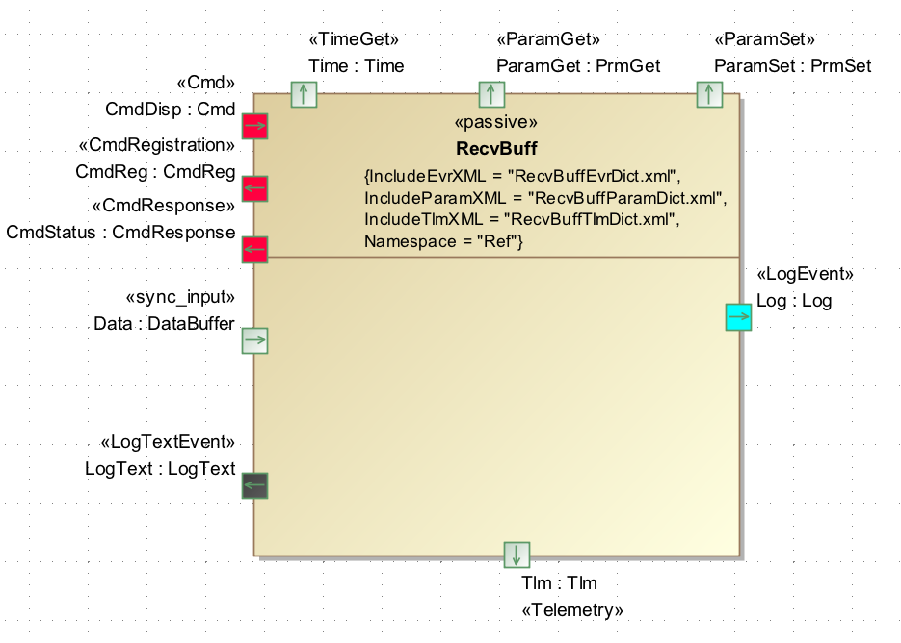
Specialized ports
Added role tag to specialized ports

Slide 14
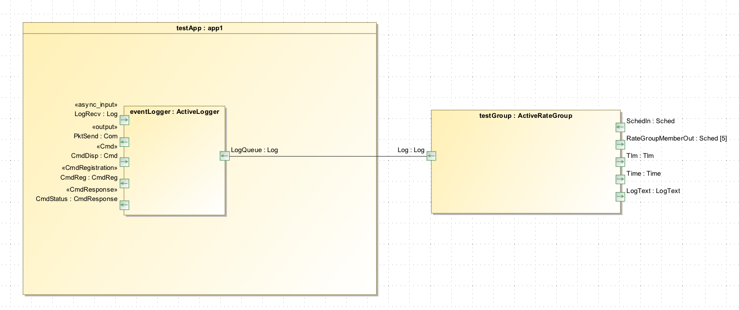
Adding to topologies
Can export models as modules
Attach external components to models from different projects

